Slide 1




Mobile Application Development
Muhammad Ashraf Baloch

Slide 2
Java Hello World First Program in Java
public class HelloWorld {
public static void main(String[] args) {
// TODO Auto-generated method stub
//System.out.println("Hello World");
}
}

Slide 3
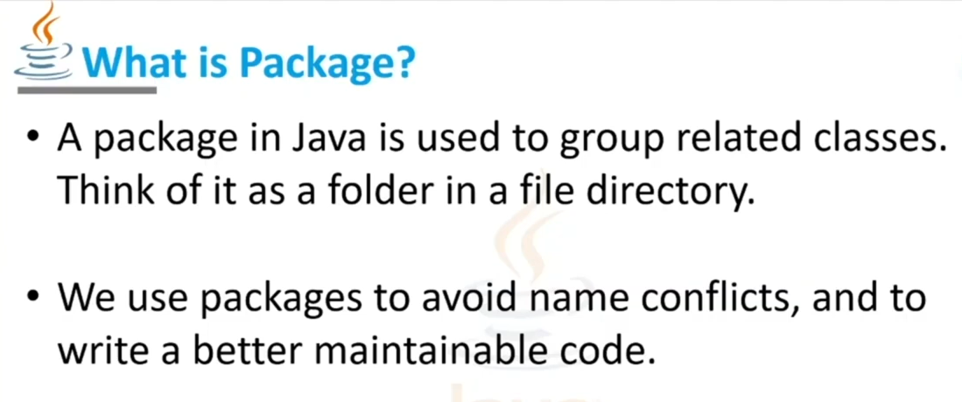

Slide 4
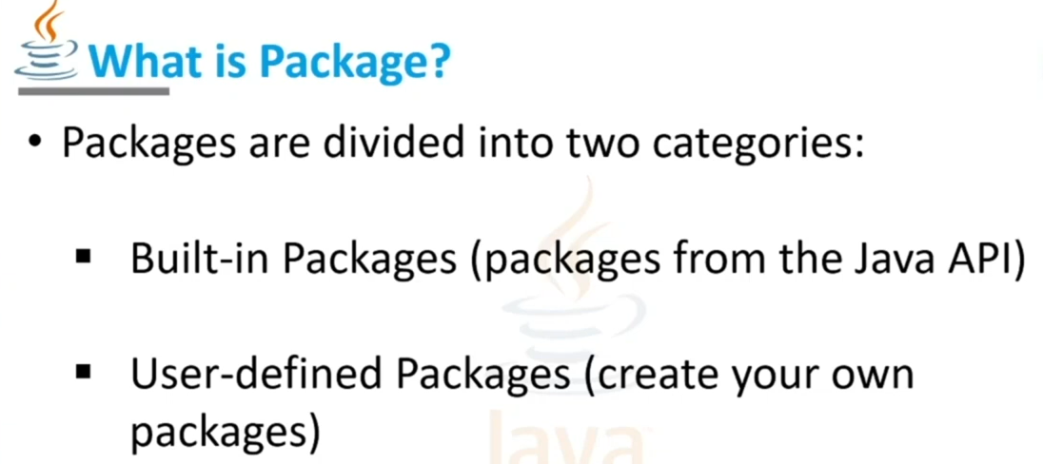

Slide 5
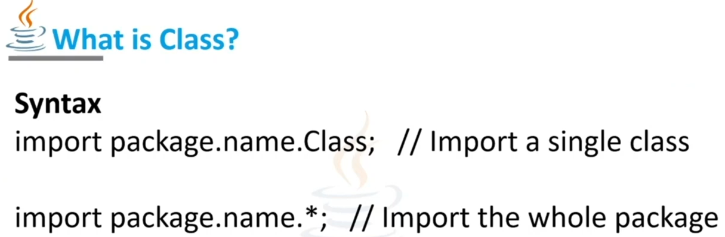

Slide 6
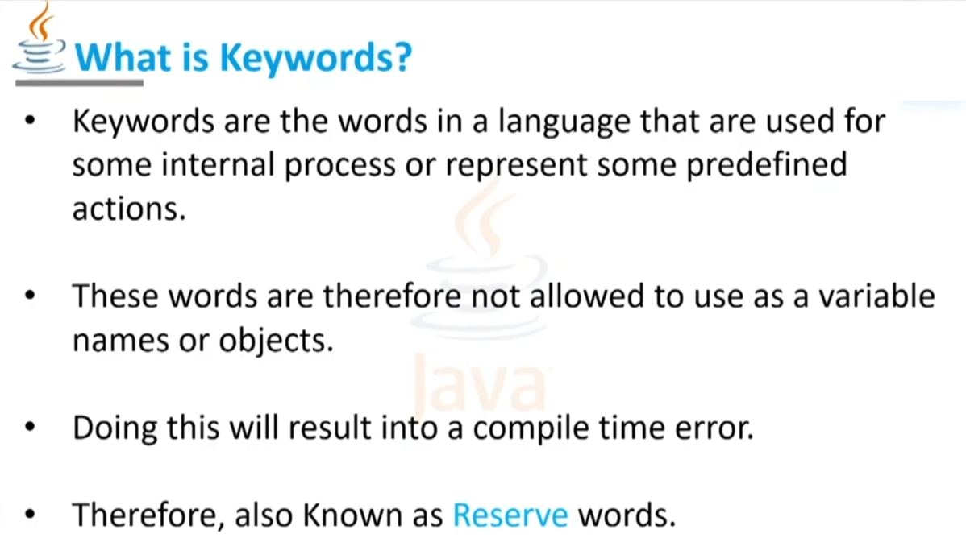
Keyword and Identifiers

Slide 7


Slide 8
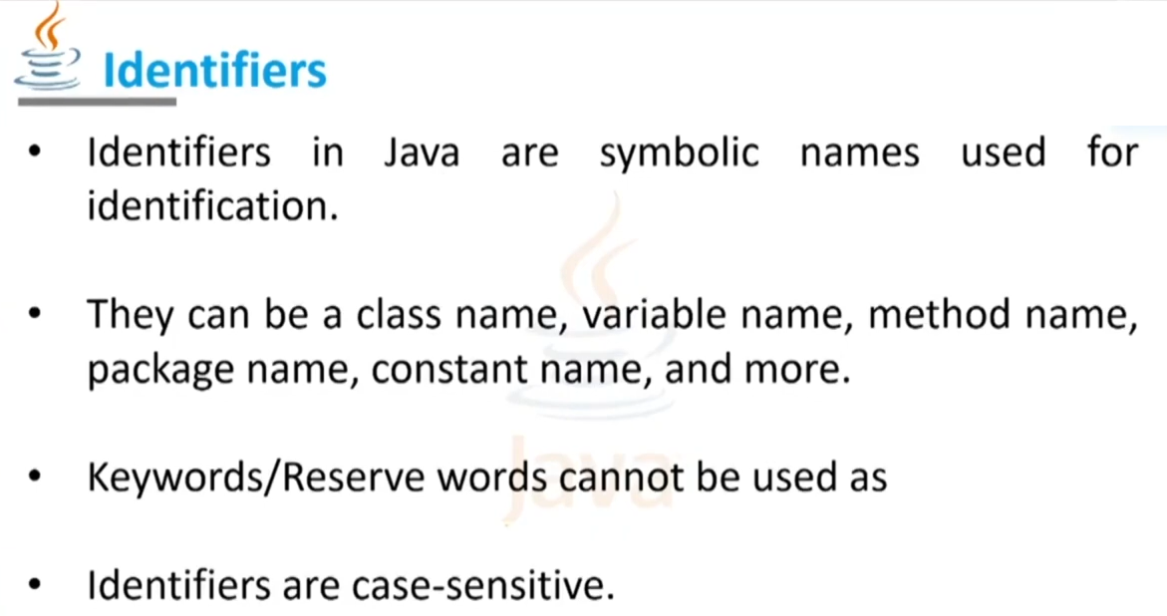

Slide 9
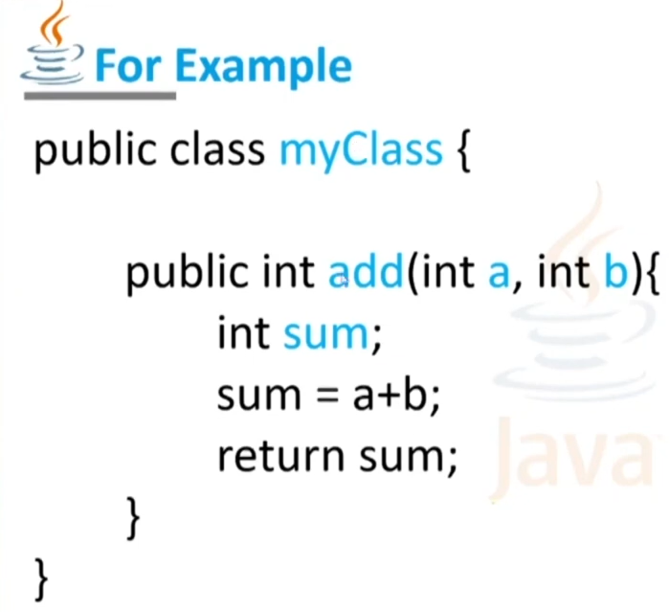

Slide 10
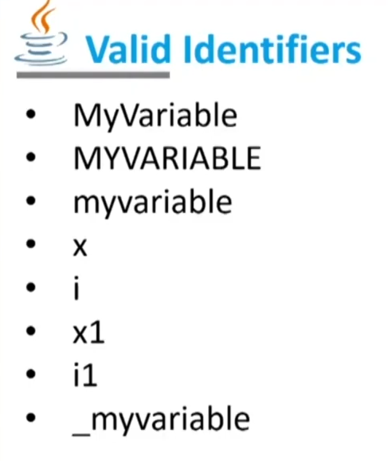

Slide 11
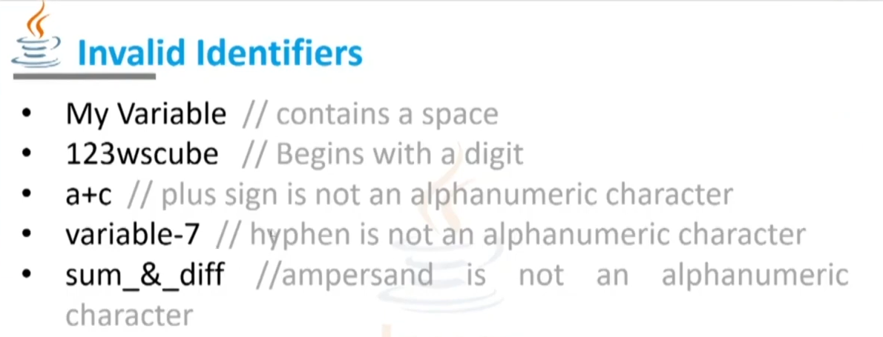

Slide 12
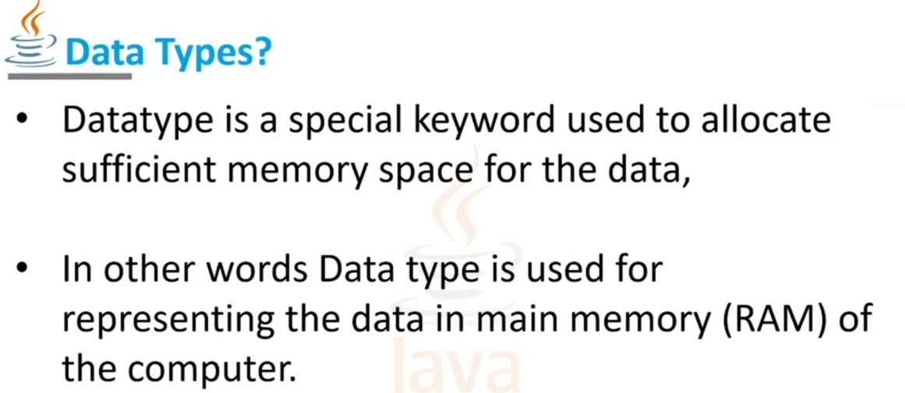

Slide 13
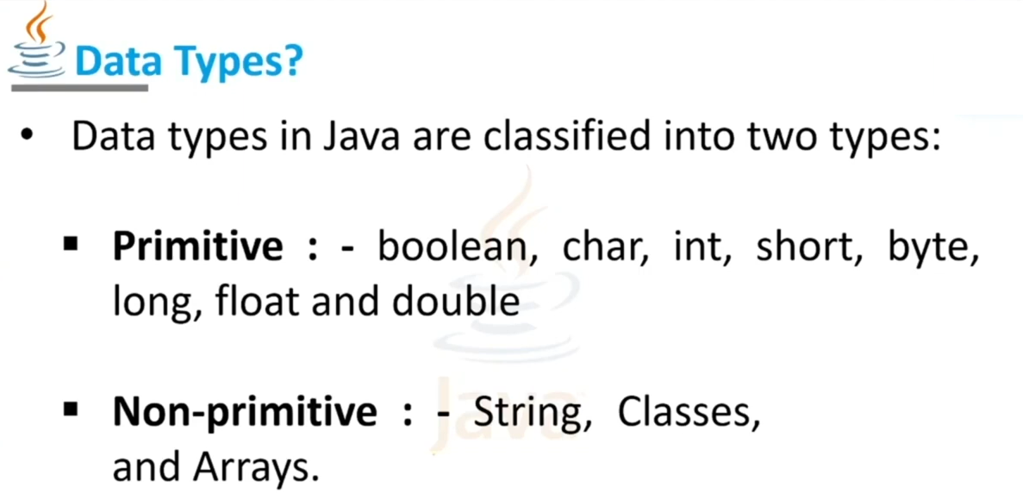
Interfaces

Slide 14
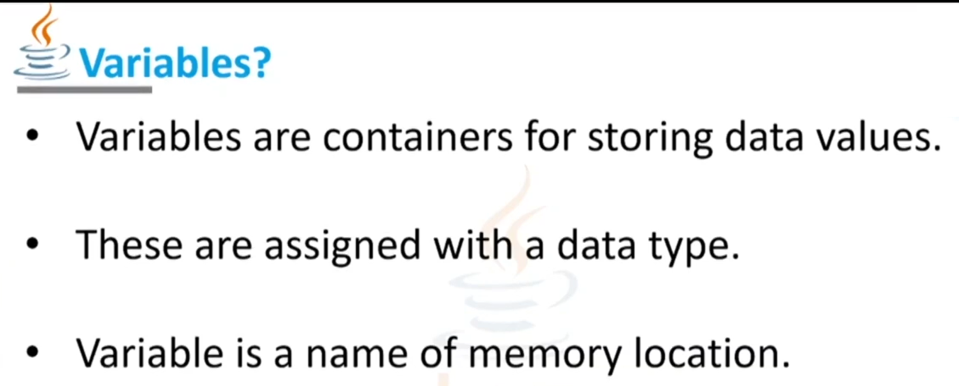

Slide 15
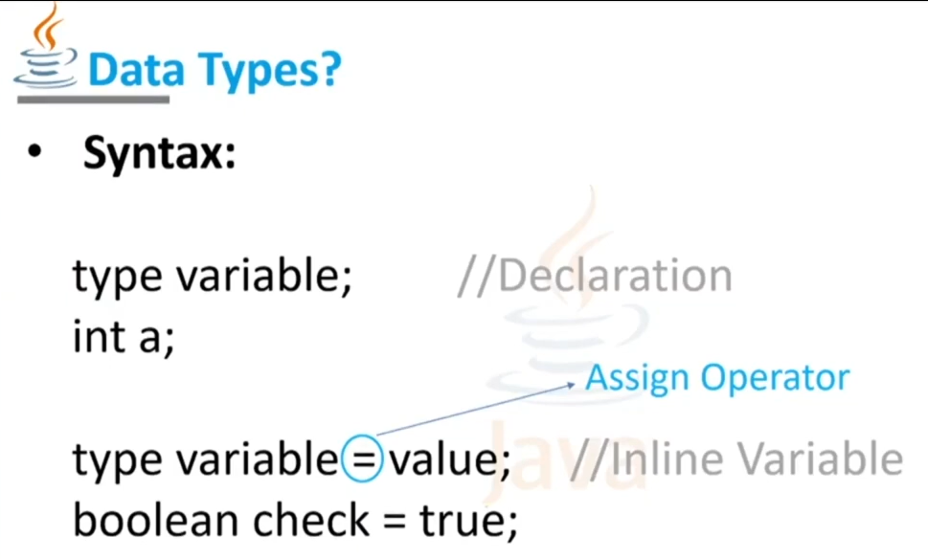

Slide 16
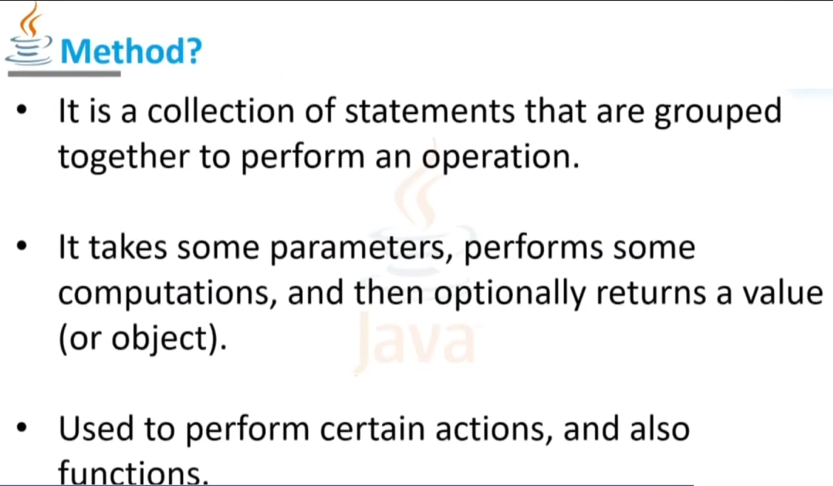
Known as

Slide 17
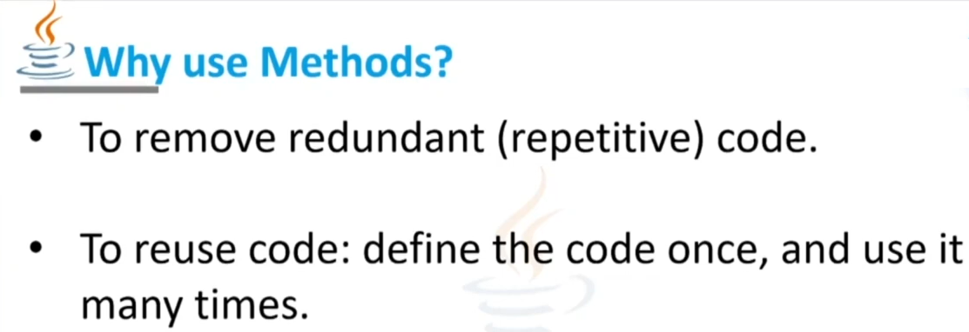
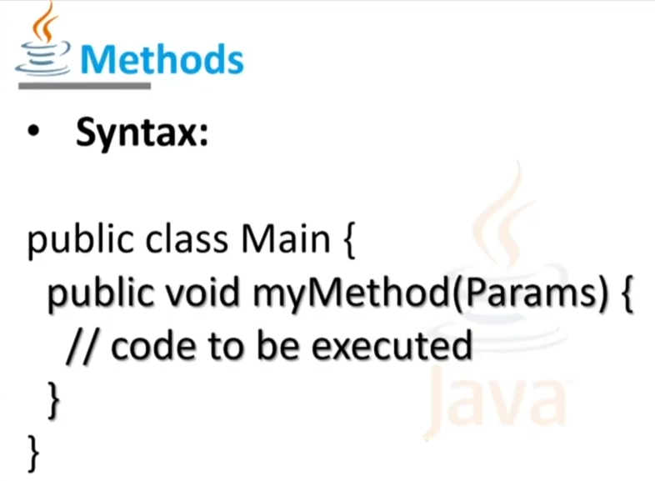
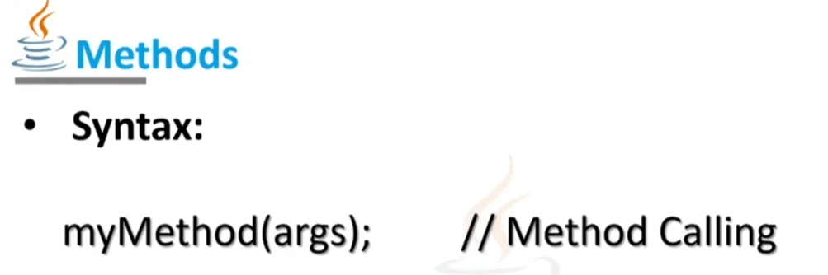

Slide 18

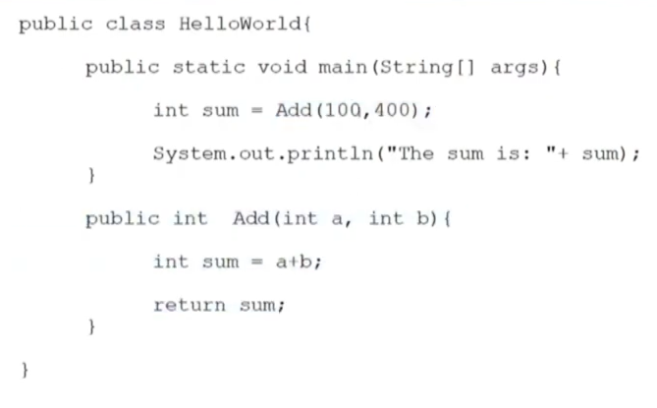

Slide 19
How to get input from user in Java
import java.util.*;
public class Hello{
public static void main(String[] args) {
Scanner reader = new Scanner(System.in); // Reading from System.in
System.out.println("Enter a number: ");
int n = reader.nextInt();
System.out.println("You Enter : " + n);
}
}

Slide 20
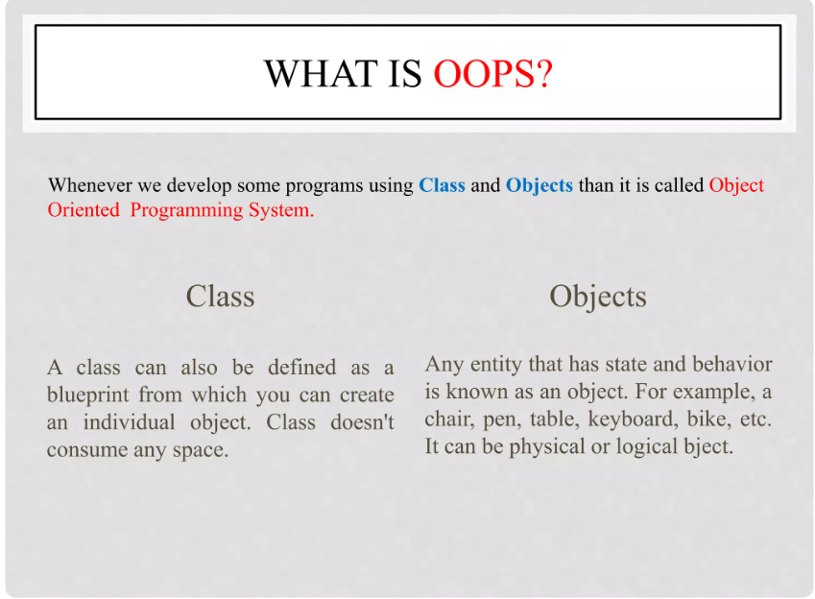

Slide 21
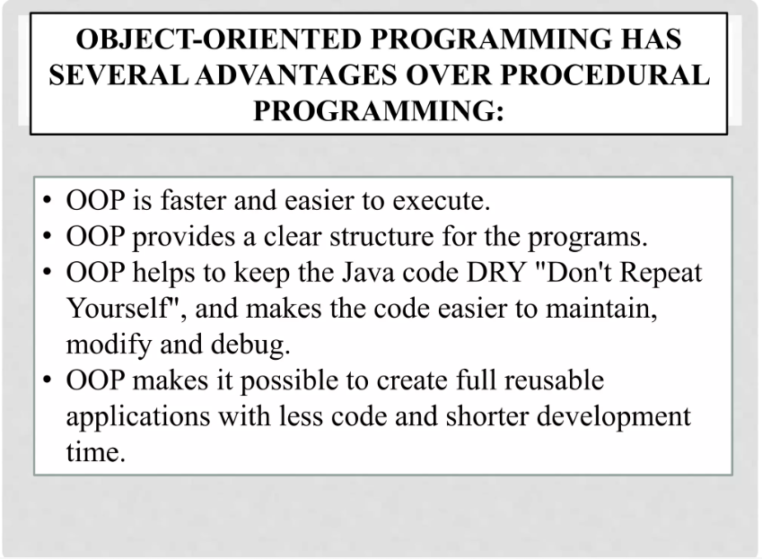

Slide 22
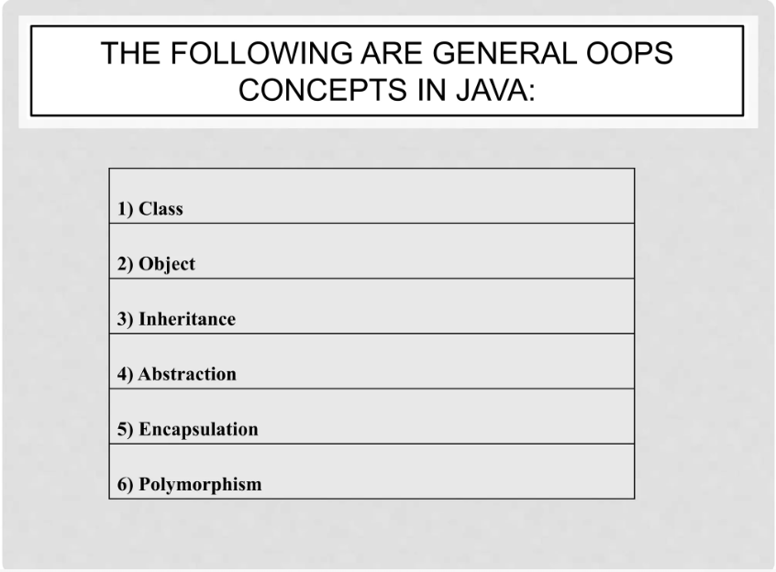

Slide 23
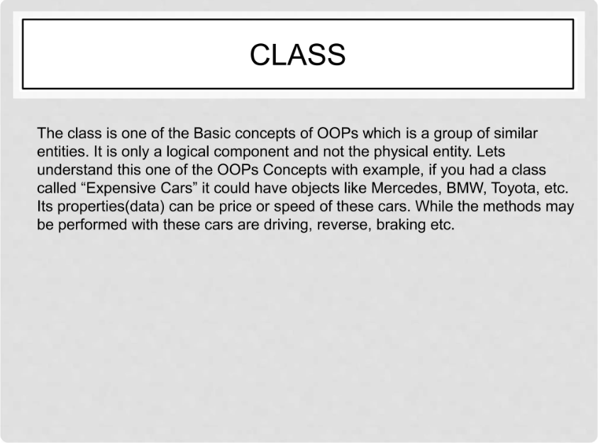

Slide 24
public class HelloWorld {
public static void main(String[] args) {
// TODO Auto-generated method stub
System.out.println("Hello world");
}
}

Slide 25
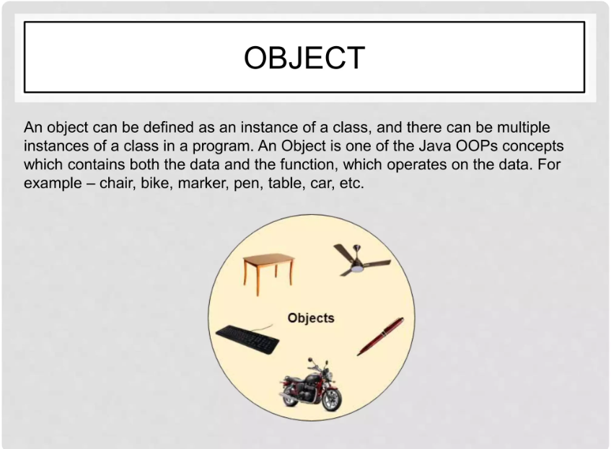

Slide 26
class Animals
{
public void eat()
{
System.out.println("Animal Can Eat");
}
public void Display()
{
System.out.println("Display Fun of Parent");
}
}
class Cats extends Animals
{
public void eat()
{
System.out.println("Cat Can Eat");
}
}
public class MainInheritance {
public static void main(String[] args)
{
Animals AnimalObj = new Cats ();
AnimalObj.eat();
Cats CatObj = new Cats();
CatObj.eat();
}
}

Slide 27
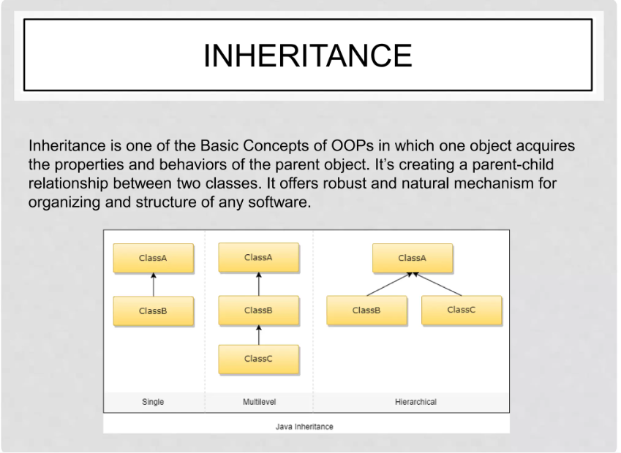

Slide 28
class Animals
{
public void eat()
{
System.out.println("Animal Can Eat");
}
public void Display()
{
System.out.println("Display Fun of Parent");
}
}
class Cats extends Animals
{
public void eat()
{
System.out.println("Cat Can Eat");
}
}
public class MainInheritance {
public static void main(String[] args)
{
Animals AnimalObj = new Cats ();
AnimalObj.eat();
Cats CatObj = new Cats();
CatObj.eat();
}
}

Slide 29
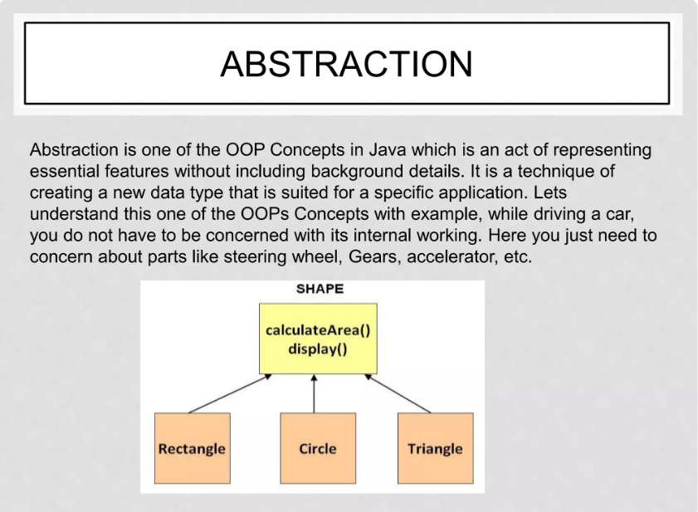

Slide 30
public class AbstractMain {
public static void main(String[] args) {
// TODO Auto-generated method stub
shape shapobj = new Rectangle(5,4);
System.out.println("Area of rectangle: " + shapobj.area());
}
}
abstract class shape
{
public abstract double area();
//void Display()
// {
// System.out.println("This is a shape.");
//}
}
class Rectangle extends shape {
private double length;
private double width;
public Rectangle(double length, double width)
{
this.length = length;
this.width = width;
}
public double area() {
return length * width;
}
}

Slide 31
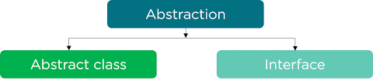
Abstraction in Java refers to hiding the implementation details of a code and exposing only the necessary information to the user. It provides the ability to simplify complex systems by ignoring irrelevant details and reducing complexity
Abstraction in Java can be achieved using the following tools it provides
Abstract classes
Interfaces
Abstraction in the real world Example
Making coffee with a coffee machine is a good example of abstraction. You need to know how to use your coffee machine to make coffee. You need to provide water and coffee beans, switch it on and select the kind of coffee you want to get

Slide 32
What is an Abstract Method?
An abstract method is a method declared without an implementation. It’s used to define the signature of a method that must be implemented by non-abstract subclasses. Abstract methods are declared using the abstract keyword and do not contain a method body. Any class containing one or more abstract methods must be declared as abstract. Example

Slide 33
public class methods
{
public static void main(String[] args) {
// TODO Auto-generated method stub
add();
sub(3,1);
System.out.println("mult " + mult( ));
System.out.println("div " + div(35,3));
}
//First Function void No Return,
No Parameter
public static void add()
{
int a,b,c;
a=1;b=2;c=a+b;
System.out.println("Sum ="+c);
}
//second Function void No Return but take Parameter
public static void sub(int a, int b )
{
int c=a-b;
System.out.println("sub ="+c);
}
//third Function Return value ,No Parameter
public static int mult( )
{
int a=2;int b=2;
int c=a*b;
return c;
}
//third Function Return value ,with Parameter
public static float div(int a, int b )
{
float result = a/b;
return result;
}
}

Slide 34
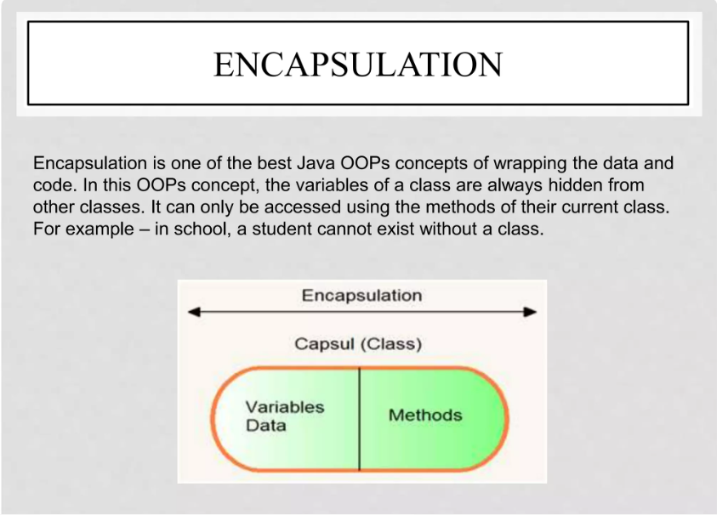

Slide 35

What is Encapsulation in Java?
Encapsulation in Java refers to integrating data (variables) and code (methods) into a single unit. In encapsulation, a class's variables are hidden from other classes and can only be accessed by the methods of the class in which they are found.

Slide 36
class Person
{
// Encapsulating the name and age
// only approachable and used using
// methods defined
private String name;
private int age;
public String getName() { return name; }
public void setName(String name) { this.name = name; }
public int getAge() { return age; }
public void setAge(int age) { this.age = age; }
}
public class EncapsuleMain {
public static void main(String[] args) {
// TODO Auto-generated method stub
// person object created
Person person = new Person();
person.setName("John");
person.setAge(30);
// Using methods to get the values from the
// variables
System.out.println("Name: " + person.getName());
System.out.println("Age: " + person.getAge());
}
}

Slide 37
Encapsulation is defined as the wrapping up of data under a single unit. It is the mechanism that binds together code and the data it manipulates. Another way to think about encapsulation is, that it is a protective shield that prevents the data from being accessed by the code outside this shield.
Technically in encapsulation, the variables or data of a class is hidden from any other class and can be accessed only through any member function of its own class in which it is declared.
As in encapsulation, the data in a class is hidden from other classes using the data hiding concept which is achieved by making the members or methods of a class private, and the class is exposed to the end-user or the world without providing any details behind implementation using the abstraction concept, so it is also known as a combination of data-hiding and abstraction.
Encapsulation can be achieved by Declaring all the variables in the class as private and writing public methods in the class to set and get the values of variables.
It is more defined with the setter and getter method.

Slide 38
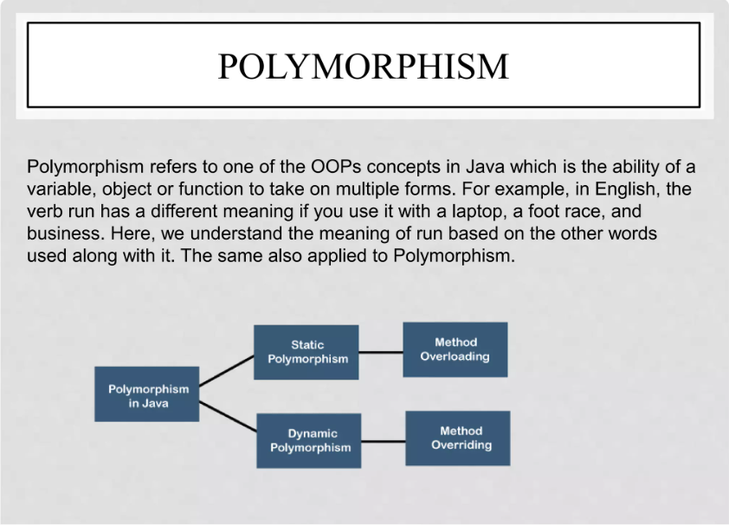

Slide 39
Polymorphism in Java
Polymorphism in Java is a concept by which we can perform a single action in different ways. Polymorphism is derived from 2 Greek words: poly and morphs. The word "poly" means many and "morphs" means forms. So polymorphism means many forms.
There are two types of polymorphism in Java: compile-time polymorphism and runtime polymorphism. We can perform polymorphism in java by method overloading and method overriding.
Types of Java Polymorphism
In Java Polymorphism is mainly divided into two types:
Compile-time Polymorphism
Runtime Polymorphism
Compile-Time Polymorphism in Java
It is also known as static polymorphism. This type of polymorphism is achieved by function overloading or operator overloading.

Slide 40
//Method OverLoading
class Helper {
// Method with 2 integer parameters
static int Multiply(int a, int b)
{
// Returns product of integer numbers
return a * b;
}
static int Multiply(int a, int b, int c)
{
// Returns product of integer numbers
return a * b *c;
}
// Method 2
// With same name but with 2 double parameters
static double Multiply(double a, double b)
{
// Returns product of double numbers
return a * b;
}
}
public class PolyMerphismMain {
public static void main(String[] args) {
// TODO Auto-generated method stub
// Calling method by passing
// input as in arguments
System.out.println(Helper.Multiply(2, 4 , 4));
System.out.println(Helper.Multiply(5.5, 6.3));
System.out.println(2 - " 2");
}
}

Slide 41
Method Overloading
When there are multiple functions with the same name but different parameters then these functions are said to be overloaded. Functions can be overloaded by changes in the number of arguments or/and a change in the type of arguments
Runtime Polymorphism in Java
It is also known as Dynamic Method Dispatch. It is a process in which a function call to the overridden method is resolved at Runtime. This type of polymorphism is achieved by Method Overriding. Method overriding, on the other hand, occurs when a derived class has a definition for one of the member functions of the base class. That base function is said to be overridden.

Slide 42
class Parent {
// Method of parent class
void Print()
{
// Print statement
System.out.println("parent class");
}
}
// Class 2
// Helper class
class subclass1 extends Parent {
// Method
void Print() { System.out.println("Child subclass1"); }
}
// Helper class
class subclass2 extends Parent {
// Method
void Print()
{
// Print statement
System.out.println("Child subclass2");
} }
}
public class PolyMorPhOverRiding {
public static void main(String[] args) {
// TODO Auto-generated method stub
// Creating object of class 1
Parent a;
// Now we will be calling print methods
// inside main() method
a= new Parent();
a.Print();
a = new subclass1();
a.Print();
a = new subclass2();
a.Print();
}

